Slide 1
Windows Server 2003 MS08-067 Exploit
By Alan Tan Jia Shun

Slide 2
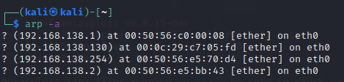
Discovery server 2003 IP using ARP

Slide 3
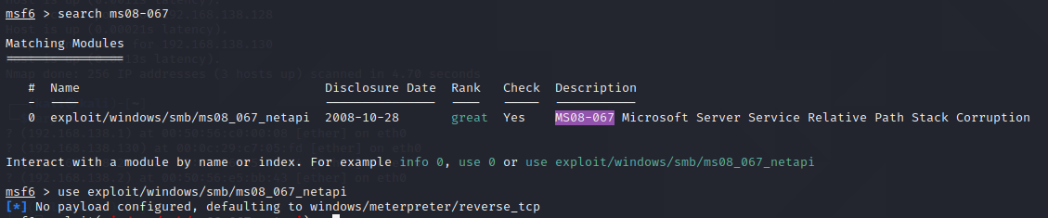
Use the exploit

Slide 4
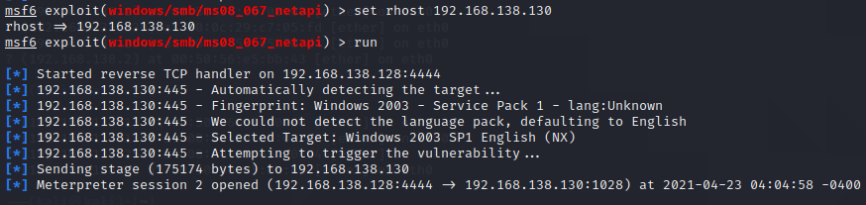
Set the RHOST

Slide 5
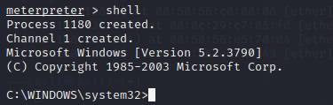
Use shell

Slide 6

Look of file

Slide 7
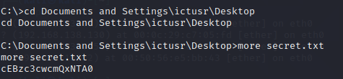
Open the txt file

Slide 8
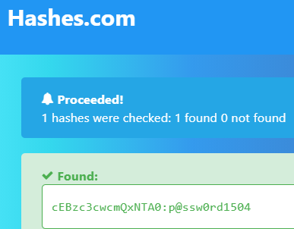
Decode the text

Slide 9
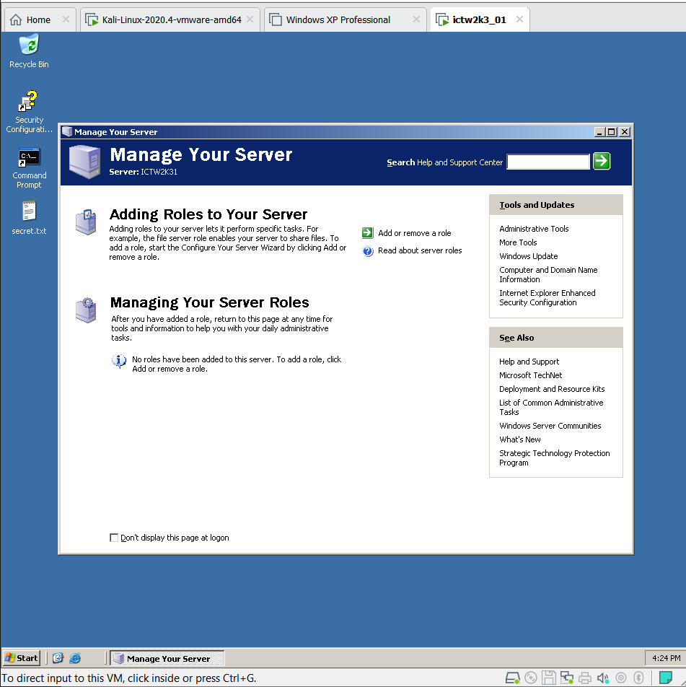
Try login on the server 2003 VM

